Slide 1
Software Reliability Engineering
Definition
Modeling
Engineering approaches
Commercial practices
References

Slide 2
Definition[1]
Software System
An interacting set of software subsystems that is embedded in a computing environment that provides inputs to the software system and accepts outputs from the software. A software subsystem it self is composed of other subsystems, and so on.
Failure
User perceives that the program ceases to deliver the expected behavior.
Fault
Identified or hypothesized cause of the software failure
Time
Most reliability quantities are defined with respect to time. It is generally accepted that execution time is more adequate than calendar time for software reliability measurement and modeling
Operational profile
The set of operations that the software can execute along with the probability with which they will occur
Software reliability measurement
Estimation
Prediction
Software reliability models
The general form of the dependence of the failure process on the principal factors that affect it
TQM
assuring the quality of the products in each phase to the next phase. Particularly, quality control carried out at the testing phase, which is the last stage of the software development process
Notes:
Lyu, M. R. (1996). Handbook of Software Reliability Engineering. Belgium: IEEE Computer Society Press.
Kanno, A. (1992). Introduction to software production engineering (in Japanese). Tokyo: JUSE Press.
Alhassan, A., Alzahrani, W., & Abdulaziz, A. (2017). Total Quality Management for Software Development. International Journal of Computer Applications, 158, 38-44.

Slide 3
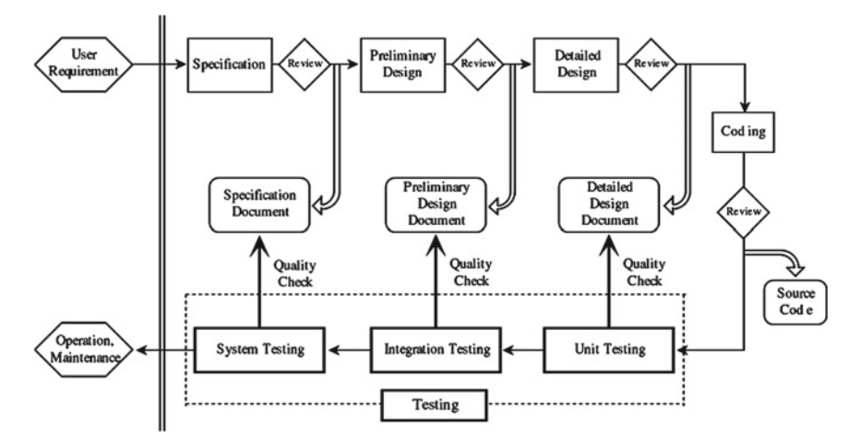
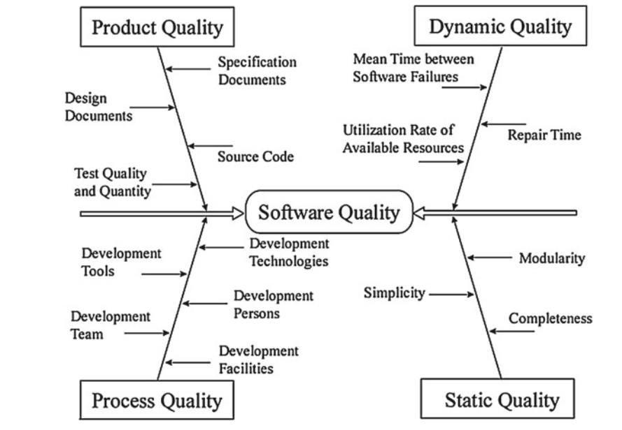
Software developments process and quality elements
A general software development process
Elements of software quality based on a cause-and-effect diagram
Notes:
Yamada, S. (2014). Software reliability modeling: fundamentals and applications (Vol. 5). Tokyo: Springer.

Slide 4
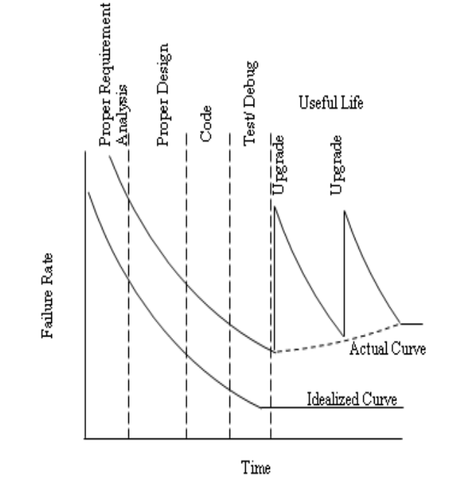
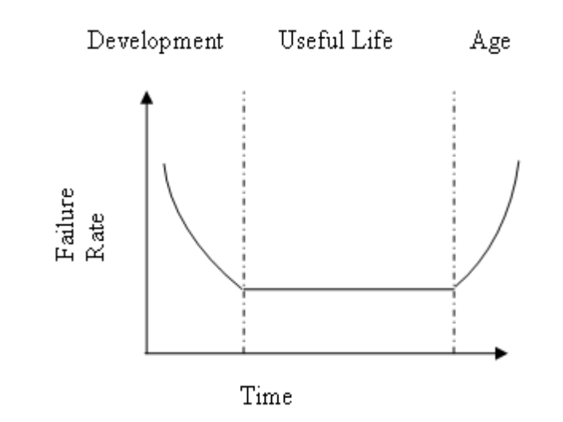
Bathtub curve for hardware and software

Slide 5
Software behaver modeling
Notes:
Yamada, S., & Ohtera, H. (1990). Software reliability: Theory and practical application (in Japanese). Tokyo: Soft Research Center.

